Slide 1
Industrialization leads to the growth of cities

Slide 2
Problem:
Buildings had been small, 2-3 stories.
Wood could not support taller buildings
If buildings were any taller, it was difficult to get to the top

Slide 3
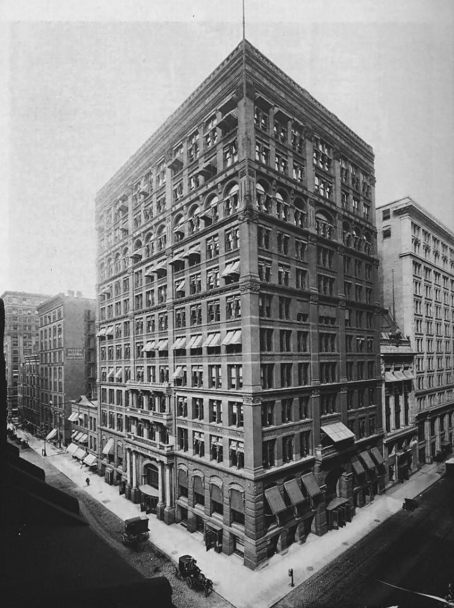
“form follows function” Louis Sullivan
Steel frames allow buildings to become stronger, and therefore taller.
The electric elevator allows buildings to become much taller.
First “sky scrapper” appears in Chicago in 1885.
The Home Insurance Building

Slide 4
Problem:
As cities grow taller, they also grow wider
How will people get around?

Slide 5
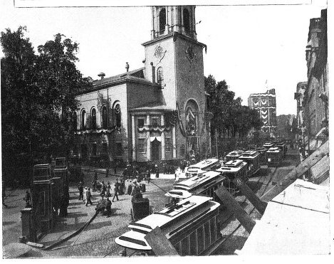
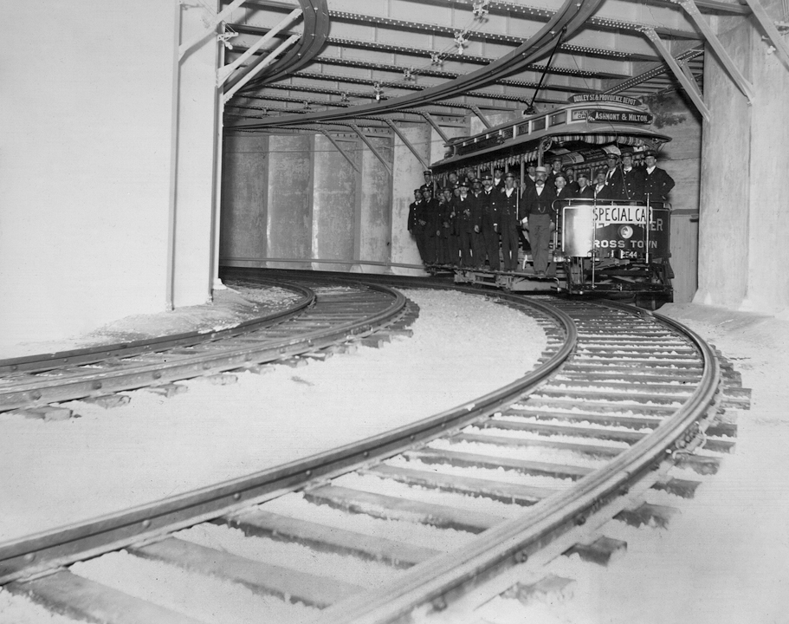
Mass Transit/Public transportation
Cities build subways and electric trolleys.
What city in the U.S. is pictured above?
Boston

Slide 6
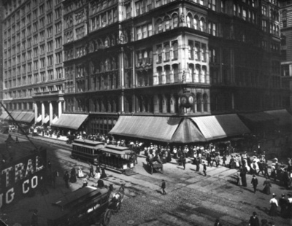
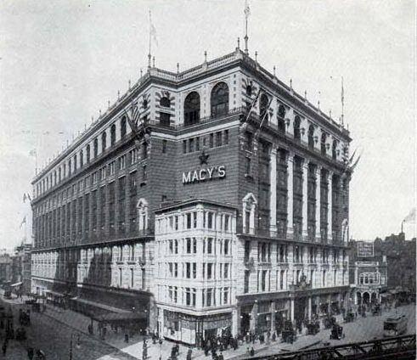
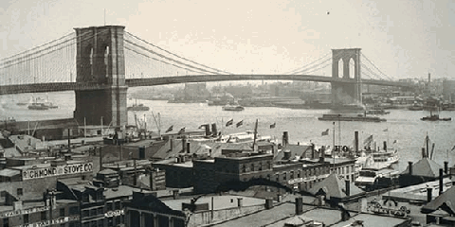
What is drawing people to the city?
Which demographic do you think is moving to the cities?

Slide 7
Problem:
People in rural areas did not produce much waste, and the waste that is produced can typically be burned, or is eaten by some animals.

Slide 8
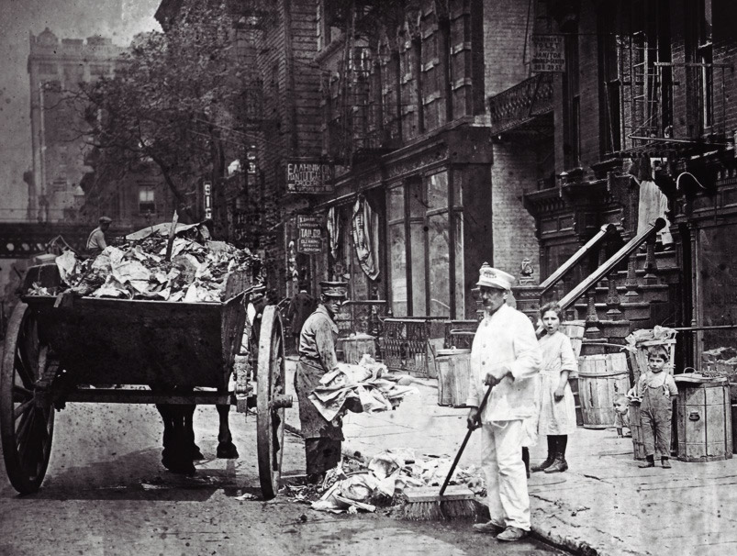
What to do with all the trash?
Waste disposal is created, however it can’t keep up the amount of waste that is created.

Slide 9
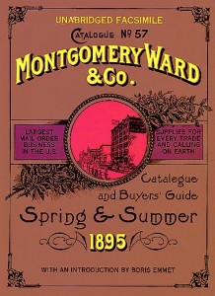
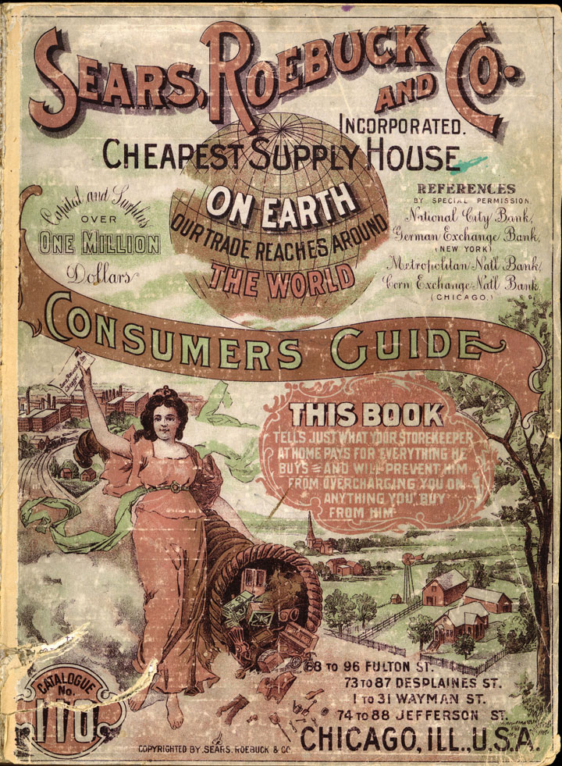
Side note:
People in the country, are also starting to purchase things from the cities, however, they are not traveling to the cities to buy them do you know what come about at this time?
Mail order catalogs
Montgomery Ward
Sears

Slide 10
Waste disposal is not the only thing that can’t keep up
Problem: Lots of people flock to the city: what should we do with all of the people that may or may not have jobs?

Slide 11
Problem:
Idea: I will move to the city, it’s glamorous and everyone has a job

Slide 12
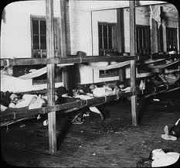
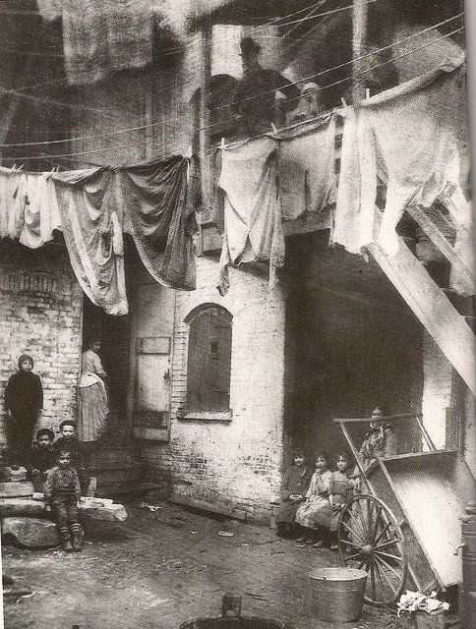
Reality: Slums and “flophouses”

Slide 13
What else do these large numbers of people do if they aren’t working?
Crime rates also increase in the cities.

Slide 14
What do a lot of the wealthy do if the cities are so crowded and dangerous
Many wealthy people begin to move to “bedroom communities” or what we now call the suburbs. To get away from the problems of the city.

Slide 15
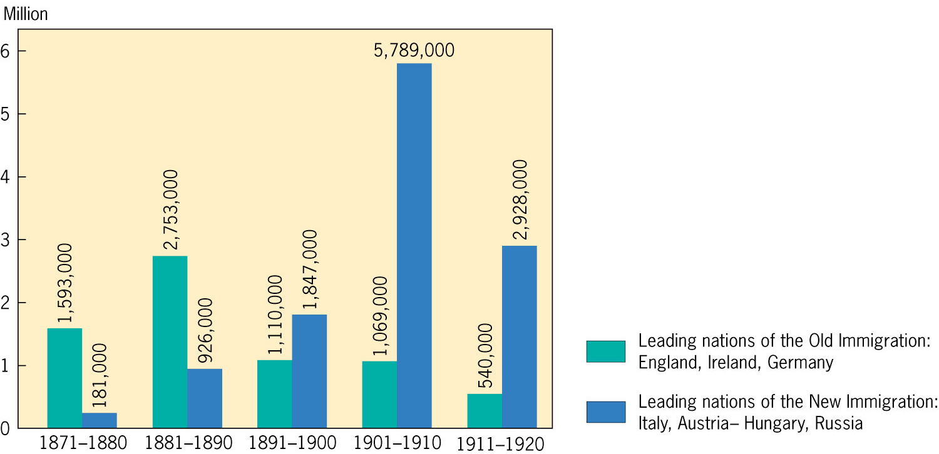
“New Immigrants”
Leads to places like “little Italy”

Slide 16
An interconnected world
Advances in farming technology didn’t just force American farmers to the cities, it also happened in European countries as well.

Slide 17
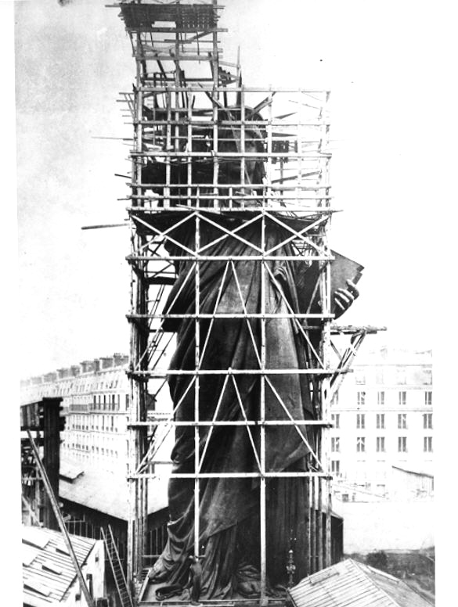
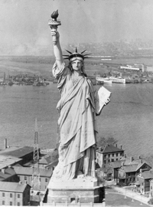

Slide 18
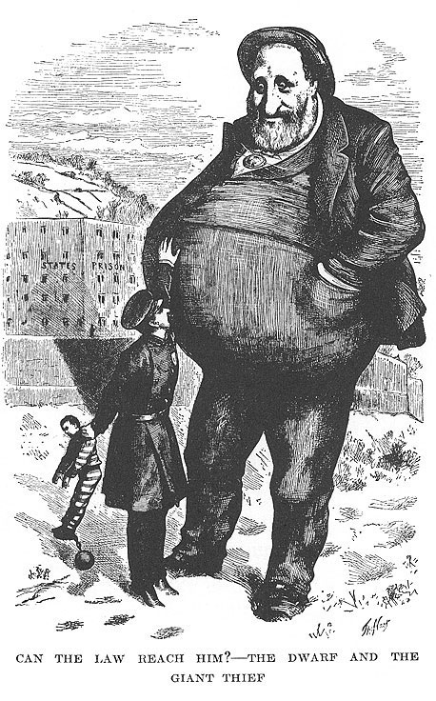
How did we treat these “New Immigrants?”
National, state, and local governments did little to help ease the transition for the immigrants.
People tend to band together with people they know, and look for help, but not from the government.

Slide 19
Settlement house
Jane Addams
Hull house helps teach in immigrants English, and help them become accustomed to American life.

Slide 20
Not all the Hull Houses did
These Hull Houses also become hubs for women’s activism.
Successfully lobbied in Chicago for anti sweatshop law.

Slide 21
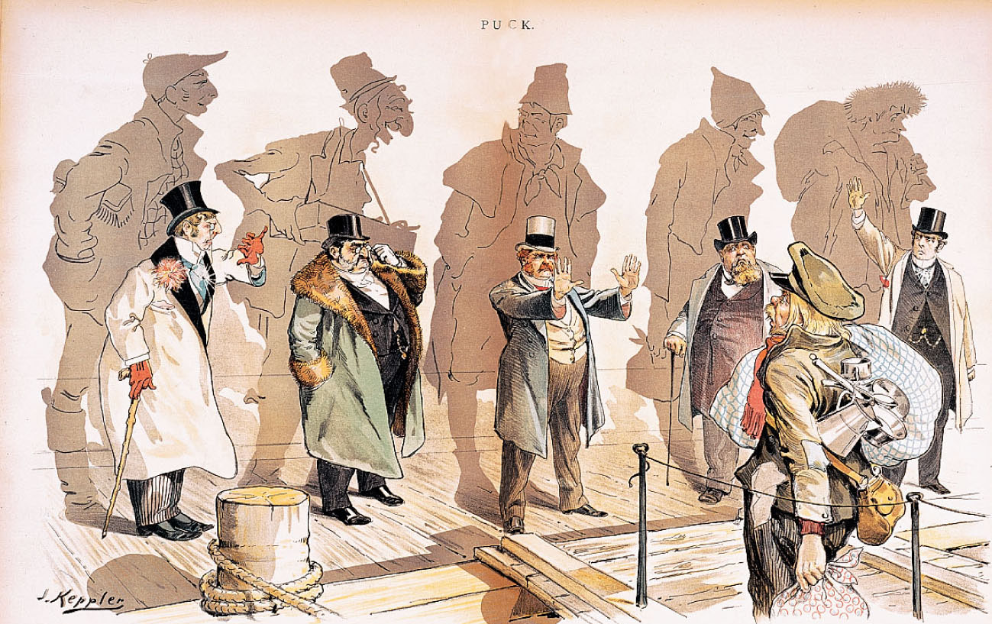
Not everyone is happy about the immigrants.
Rise of Nativism (this is the idea behind the Chinese exclusion act.)

Slide 22
What does the arrival of immigrants mean for Labor Unions?
Many immigrants are willing to work to “starvation”.
How would the “nativists” respond to this?
How do labor unions respond?

Slide 23
Government Action in regards to labor
(Other than the Chinese exclusion act)
No paupers (very poor), criminals, or convicts (1882)
No importation of foreign workers under contract (1885)
If we have tariffs to protect industry, why can’t we have tariffs to protect workers.

Slide 24
Religion in the city
What do you already think is going to happen?
Raise of liberal Protestants
sought to incorporate modern culture into the church reject literal interpretation of the Bible

Slide 25
What about immigrants and religion?
Roman Catholics, and Jewish religions see a large increase because of the large number of immigrants.

Slide 26
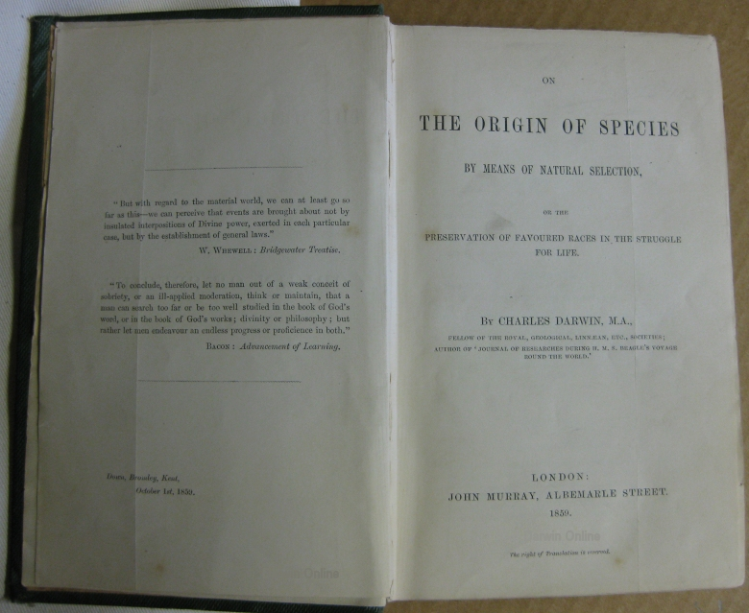
A challenge to the church

Slide 27
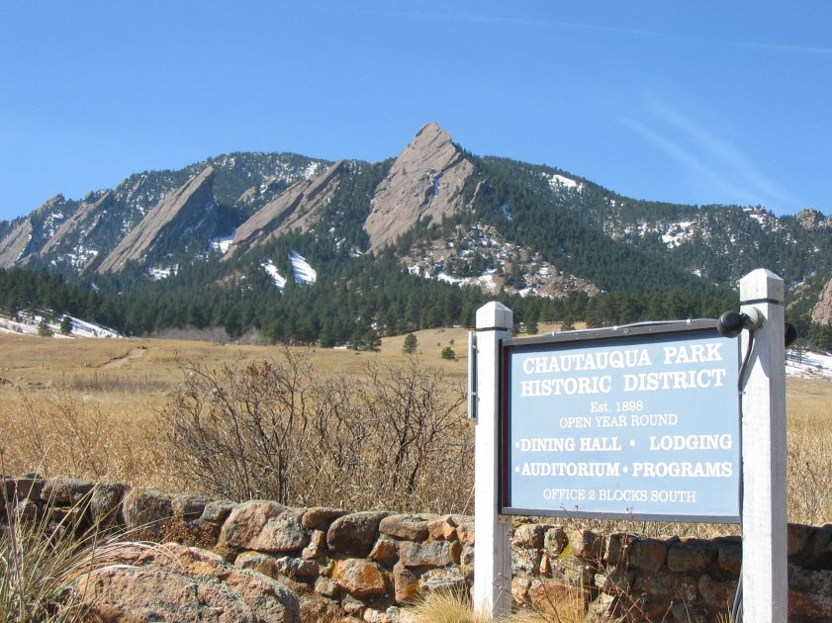
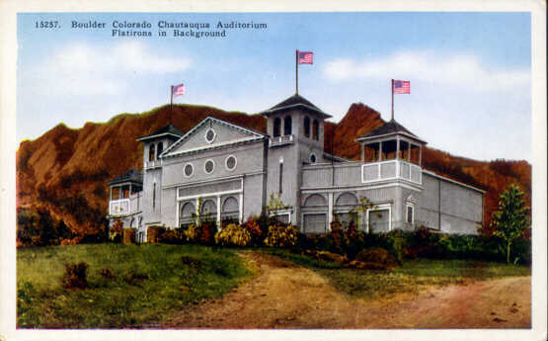
Public education continues to grow
But what about adults?
Chautauqua movement

Slide 28


Colleges begin to grow as well
Land-Grant Colleges
Land given to states by the federal government for the purpose of college education. Many of them become agriculture schools and teach military training.

Slide 29
Education changes
Many schools also begin to adapt the elective system.
Following the Civil War many medical schools begin to thrive as well.

Slide 30
African Americans during this time
Booker T. Washinton v. W.E.B. Du Bois
Washington: Founded the Tuskegee Institute and tried to teach them trades. Wanted to teach them to live in the world they live in. Gradual equality.
W.E.B Du Bois: Founded the NAACP, and wanted equality right now,

Slide 31
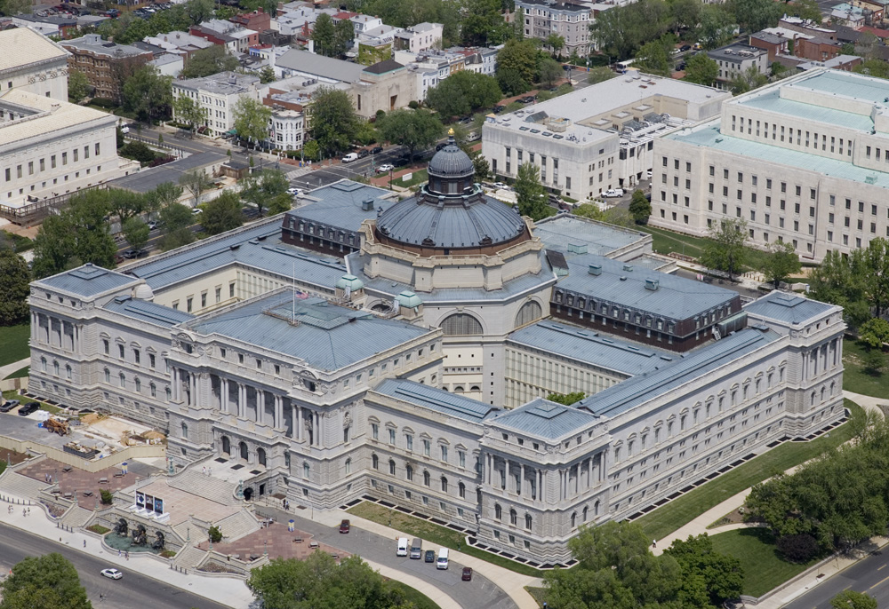
Rise of Journalism
Library of Congress 1897
Joseph Pulitzer, begins “Yellow Journalism”
Using colored comic strips.

Slide 32
Families in the city
What do you think is going to happen to family size during this time?

Slide 33
Women’s equality
National American Woman Suffrage Association (NAWSA)
What else are they fighting for?

Slide 34
Women are pushing for other rights as well
Woman’s Christian Temperance Union (WCTU) (1874)
Will come up again later, they are pushing for prohibition.

Slide 35
Literary Changes
Realism: What life is really like (Mark Twain)
Naturalism: (Some people are portrayed accurately, so truths are stretched a bit)
Regionalism: Local ways of life

Slide 36
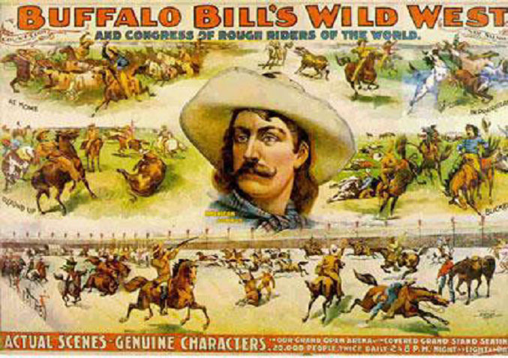
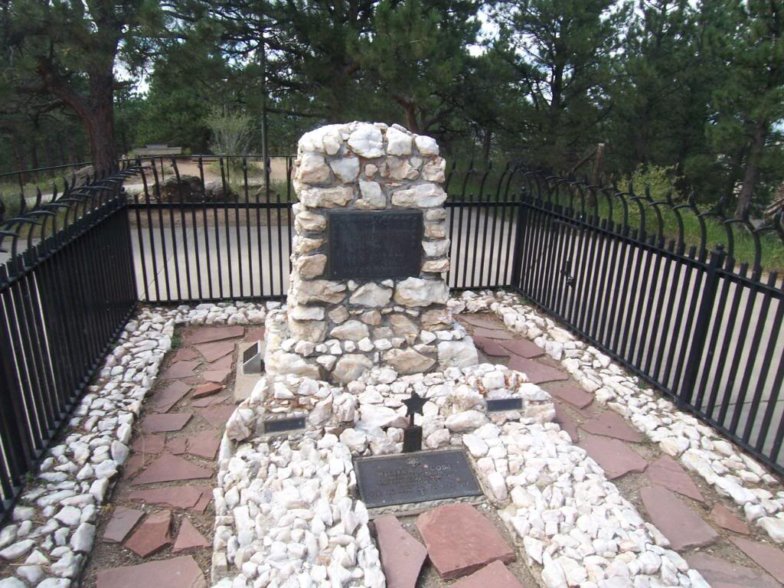
Other forms of entertainment

